Slide 1
Videogame Sales Analysis
File created on: 10/3/24 3:10:06 PM GMT+2

Slide 2
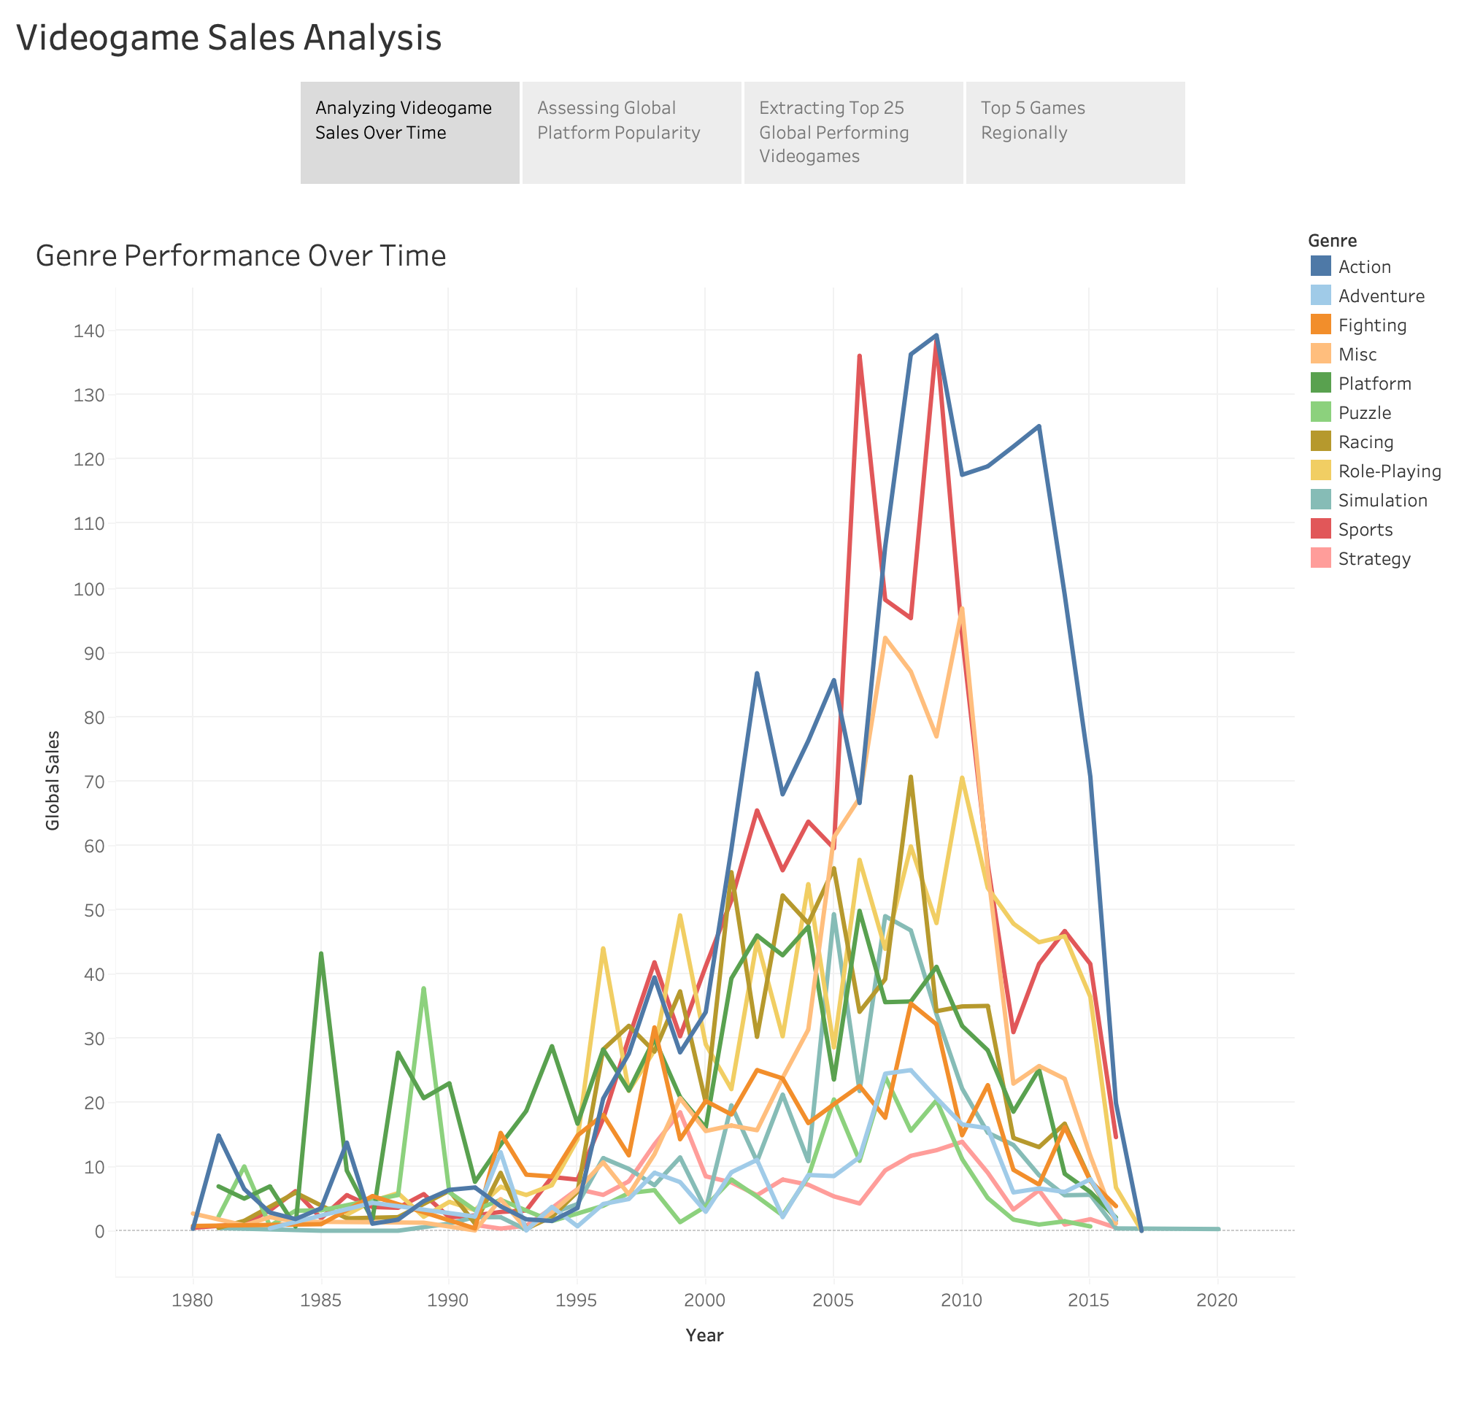

Slide 3
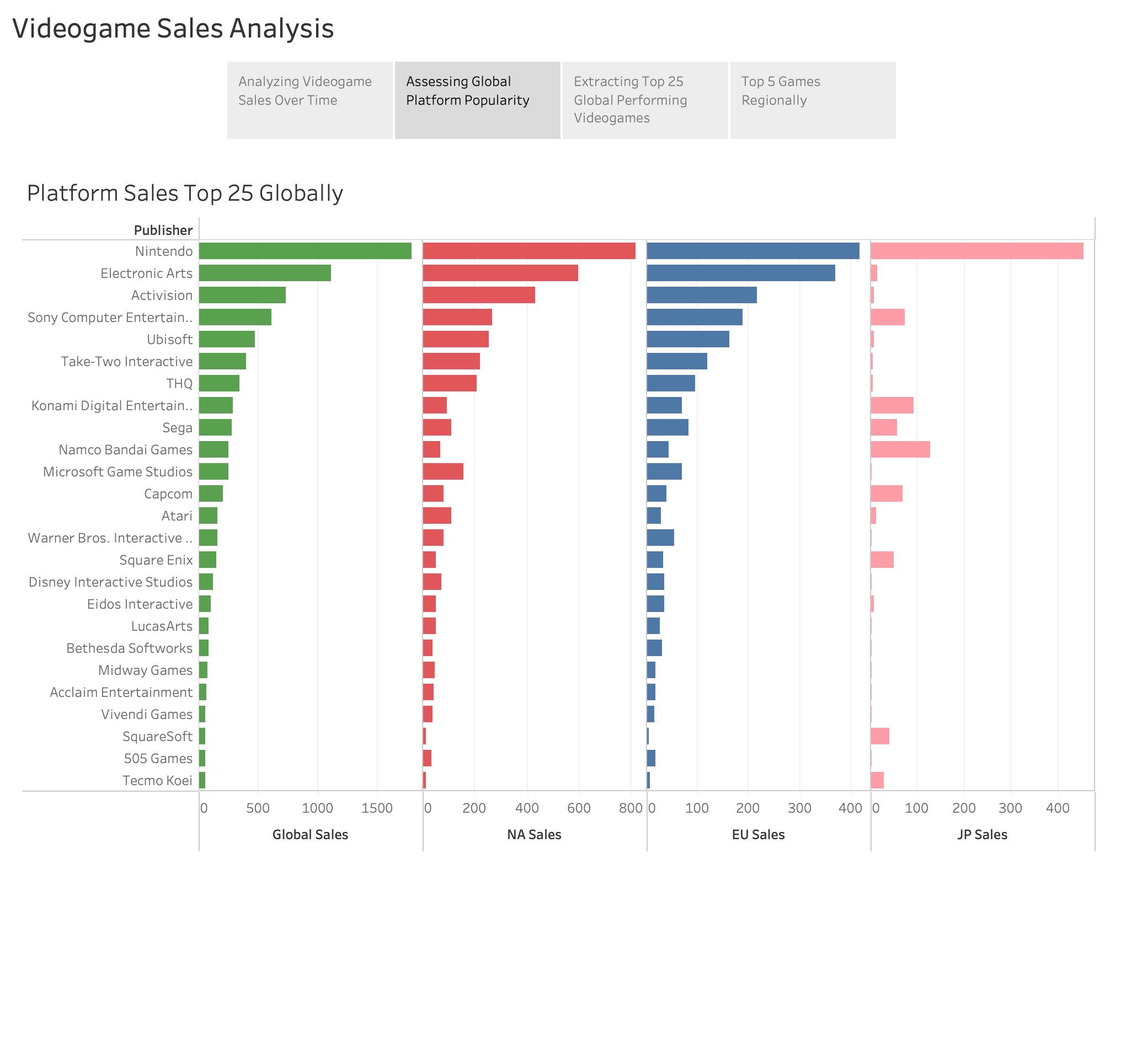

Slide 4
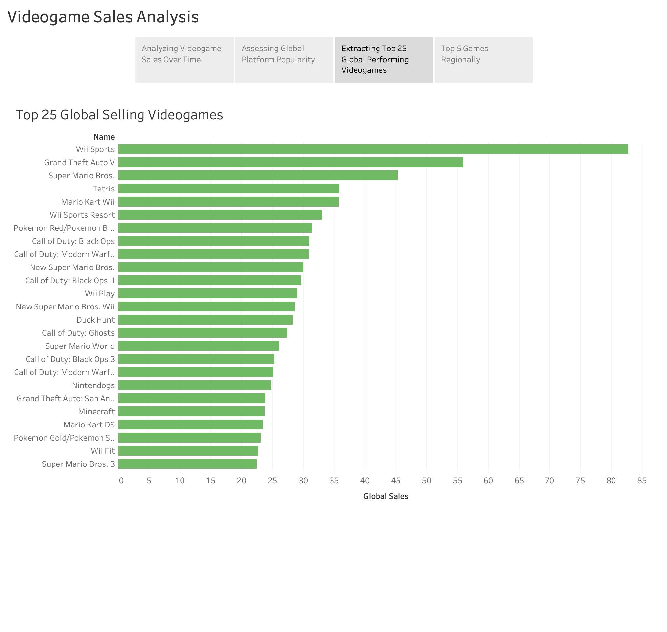

Slide 5
